Slide 1



School management system
Project made by: Omer Zafar, Neha Naseem dua khan, Rayan-ul-Haque

Slide 2
Technology used
Visual Studio 2019
Microsoft SQL Server 2022
C# WinForms
.NET framework

Slide 3
ERD diagram
Tbl_admin
tbl_classes
ad_password
Class_id
adds
Std_admissiondate
Class_name
ad_id
ad_name
tbl_student
Class_fees
Get details
pays
Std_fk_ad_id
std_id
std_name
std_gender
tbl_student_status
tbl_fees
std_fname
fee_date
fee_id
ss_id
status
fee_fk_st_id
ss_class_id_fk_id
fee_amount
Ss_std_id_fk
Ss_year

Slide 4
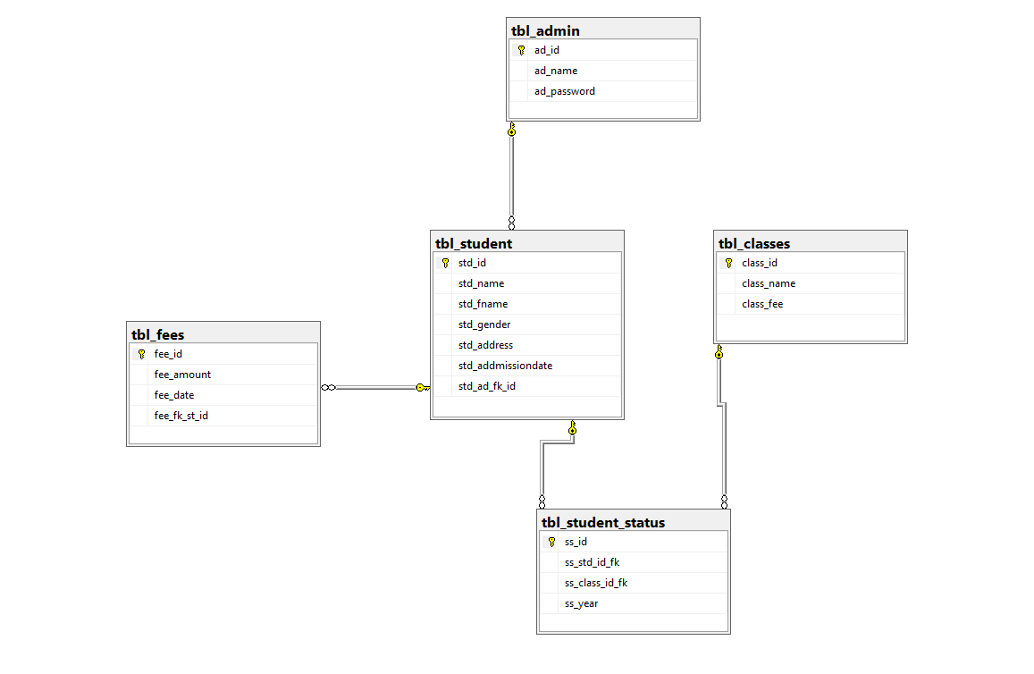
Database Relational schema

Slide 5
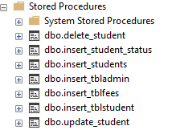
Store procedures
stored procedure allows you to encapsulate a series of SQL statements into a single unit, which can then be called and executed from various parts of an application or directly from the database.
Here are the list of store procedure used

Slide 6
Syntax to make store procedure
Create proc insert_students
(
@std_name nvarchar(30),
@std_fname nvarchar(30),
@std_gender nvarchar(6),
@std_address nvarchar(100),
@std_addmissiondate nvarchar(20),
@std_ad_fk_id int
)
as
begin
insert into tbl_student(std_name,std_fname,std_gender,std_address,std_addmissiondate,std_ad_fk_id)
values (@std_name,@std_fname,@std_gender,@std_address,@std_addmissiondate,@std_ad_fk_id)
end

Slide 7
Connecting database to WinForms application
Add Required References:
To interact with MS SQL database in C#, we need to add the necessary references to our project"System.Data.SqlClient.",
Establish the Database Connection:
In your C# code, import the System.Data.SqlClient namespace. Then, create a SqlConnection object and provide the connection string. The connection string includes the server name, database name, and provider name.

Slide 8

Connection string
We passed the connection string path in app.config file so it can access the database

Slide 9
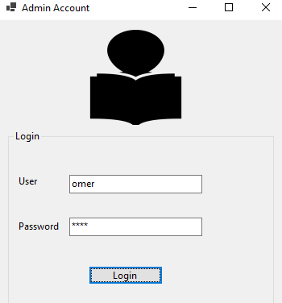
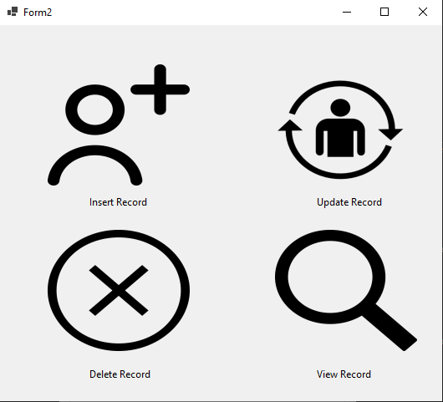
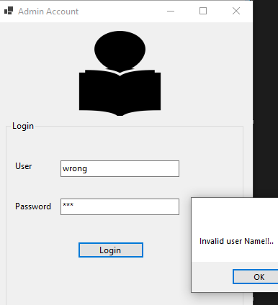
Only admin can access the application to add, delete ,update and view student records
Valid Admin
It retrieve the admin details from admin table
Not A valid User

Slide 10
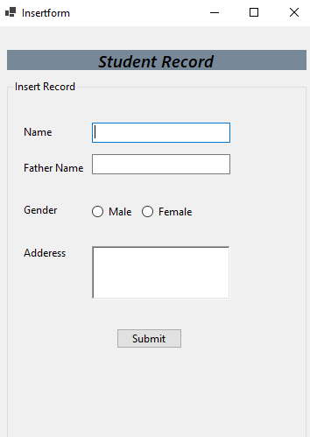
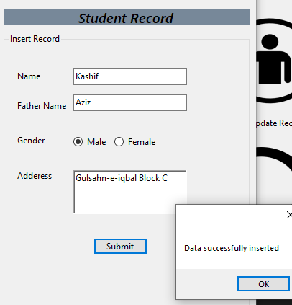
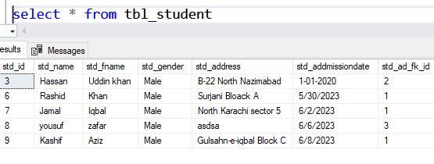
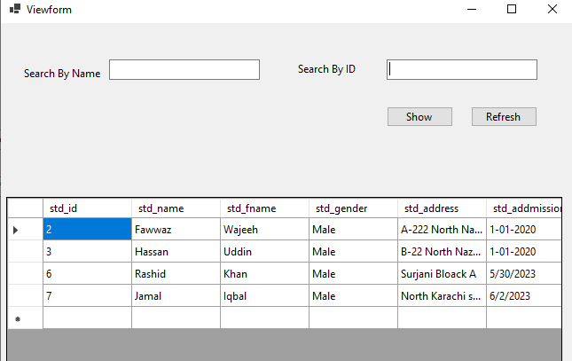
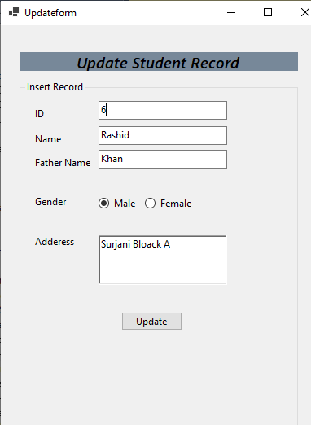
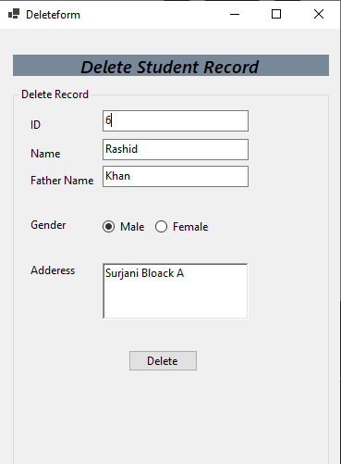
Forms used in our project
Data Is inserted in the table
View Record Of student

Slide 11
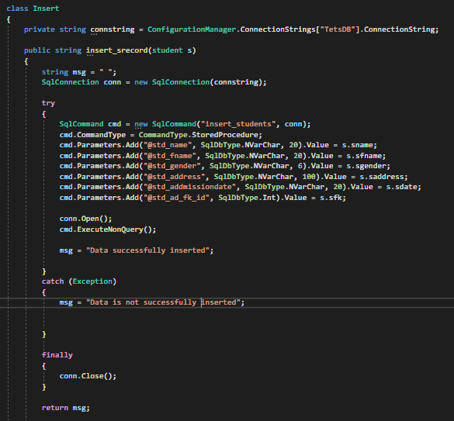
Using Store procedure and connection string
We used SqlCommand class to excute the store procedures.
To execute a stored procedure that doesn't return any data, use the ExecuteNonQuery() method.
Insert Class Code

Slide 12
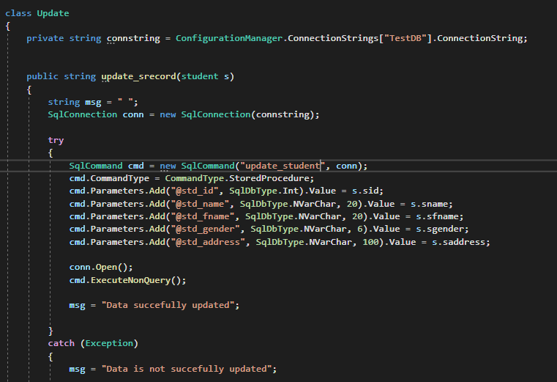
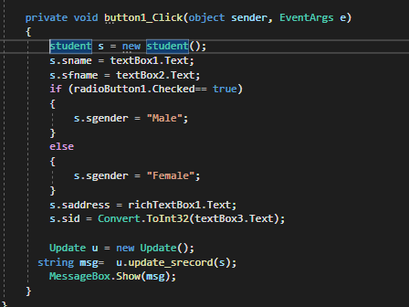
Update class code
We are using update_student store procedure to use the update query to update the recored in our database
When ever the update button is clicked it saves the update data in the database.

Slide 13
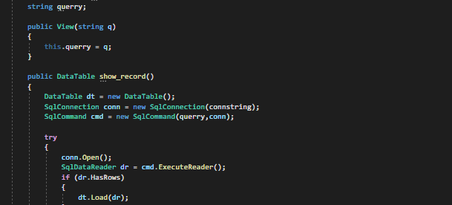
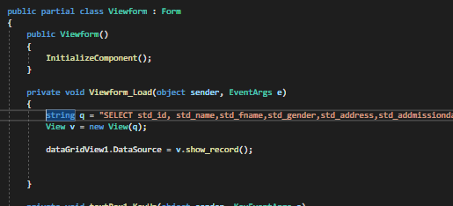
How to read data from database
To execute a stored procedure that returns a set of records, use the ExecuteReader() method.
When the view form is opened this query runs and display the student details.

Slide 14
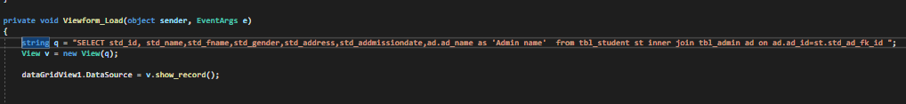
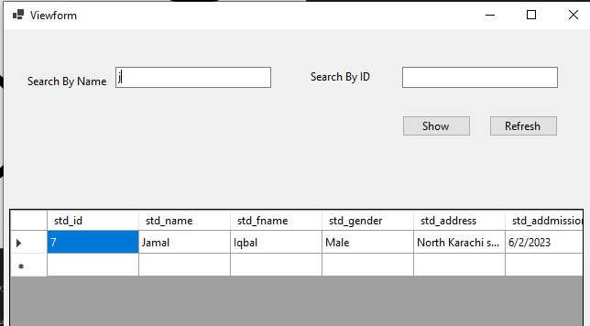
Fetching student record from database
When Ever the ViewForm is open It will fetch all the student records and display in the dataGridView
Here is an example

Slide 15
Crystal reporting
We are still working on crystal reporting so that we can print the student detail ,fees voucher etc.
It will generate a PDF file for the requires information.

Slide 16

Thank you

